Slide 1


Presentation on Final Project of Artificial Intelligence (CSCI-6660-01-S20)
Automated Podcast Generation
Submitted to: Dr. Vahid Behzadan Assistant Professor of Computer Science and Data Science University of New Haven
Submitted by:
Bibek Upadhayay bupad1@unh.Newhaven.edu
Notes:
Hello Everyone, I am Bibek Upadhayay. I am a Computer Science Graduate student. I am to present our project “AI News By AI”

Slide 2
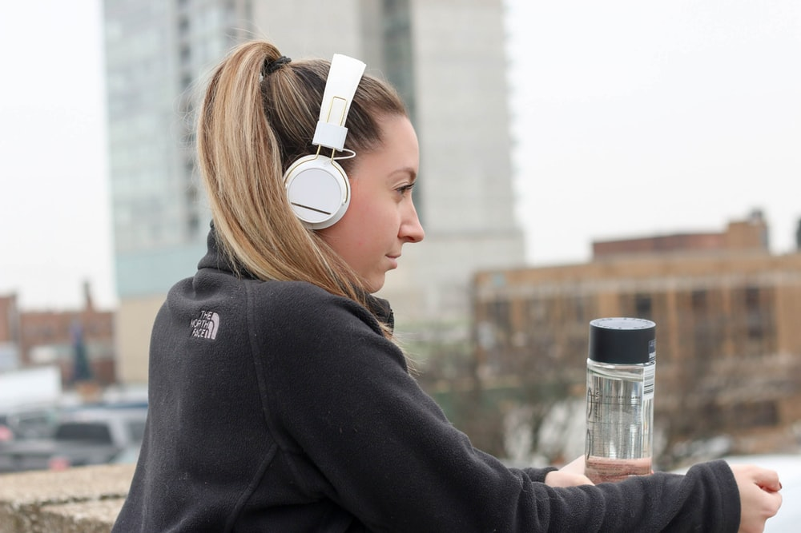

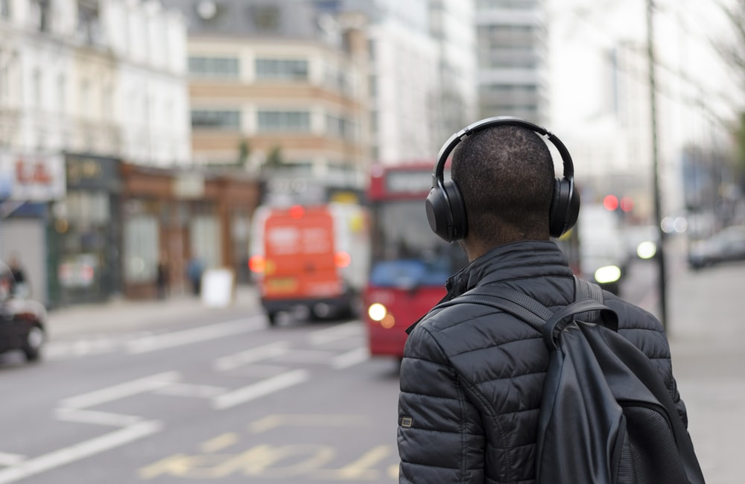
Problem
More than 51% of US population has listened to Podcast in 2019
Only 35% of those listen to the whole podcast
The reason behind this is that the content was not interesting for them
Q. How can we make Interesting Podcast?
Let’s use AI to create Podcast.

Slide 3
Objective
To create a project to satisfy the requirement of final project for Artificial Intelligence (CSCI-6660-01-S20)
To use the available knowledge of artificial intelligence and technology to create an application
To develop an automated system that creates a podcast by itself and publish the podcast to respective platform
To develop an automated podcast generation system that automatically creates the podcast by using available content in the web

Slide 4





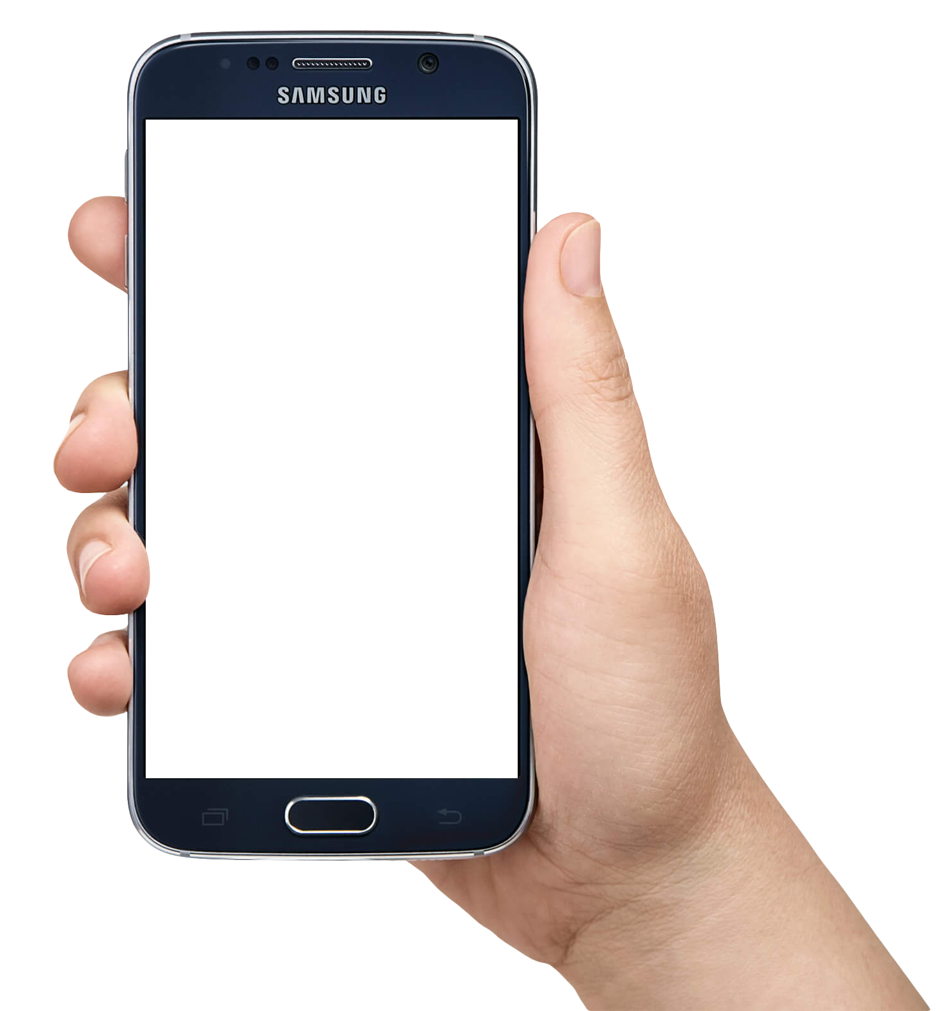
Approach
2. BROADCAST MEDIUM
2. BROADCAST MEDIUM
3. PODCAST LISTENERS
1. PODCAST STUDIO
3. PODCAST LISTENERS
AI
1. AI BASED AUTOMATED PODCAST GENERATION SYSTEM
On the left it is typical podcast system, where podcast host creates and publish the podcast on respective platform

Slide 5
Approach
Our objective is to replace the podcast host by generating the podcast using AI
We are going to use AI to create an interesting content for a particular user
We will be creating a podcast for an artificial intelligence news
The technology we are going to use are
Python
Google WaveNet for speech generation
Google API
Apple iTunes platform to host the podcast

Slide 6





Approach
HOW DOES THE SYSTEM WORK?
Step1: We will extract the news content from the respective website
Step2: We will filter the content and separate each news.
Step3: the system will takes those Speech Files and use Google API to convert them into speech files
Step 4: the system will combine the speech files and background music to create a full podcast episode
Step 5: The system will generate and update the .XML file and submit to Apple iTunes to publish the podcast
Website #1
System Algorithm
Podcast Episode

Slide 7
Evaluation Methodology
An executable python code that will do the following things
Display the title and content of the cleaned news
Will create an audio podcast generated by the system
An .XML file that auto-updates for publishing podcast
Link to the iTunes for published and approved podcast.

Slide 8
Methodology
Environment Setup
Create a virtual environment
pip install google-cloud-texttospeech
pip install feedparser
pip install AudioSegment
pip install pydub
Google Credentials for API: Get the .json credentials from Google Cloud
.XML File setup: Need to follow the iTunes podcast rss format for the .XML file
The program extract the text content from https://artificialintelligence-news.com/feed/ . The text is first cleaned via cleanText() function

Slide 9
Few important notes:
Google only allows <5000 characters to be converted so the recursive function feed_fragmentation() function slice the larger text and convert them into smaller audios and later these audios are combined.
For each episode the xml file need to be updated
For the headline audios, the algorithm makes sure that the background music automatically increase-decrease in volume.

Slide 10
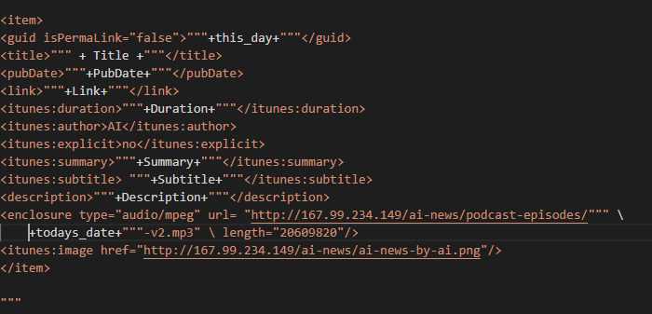
For every episode, this code is added in .XML file

Slide 11
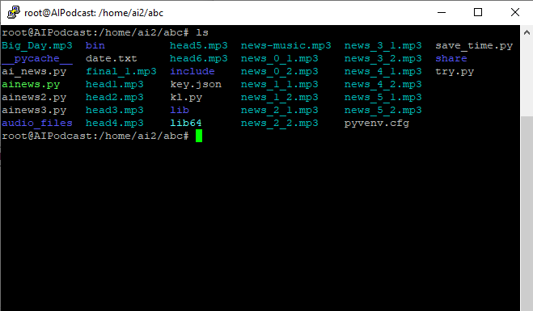
Files generated after the running the code.

Slide 12
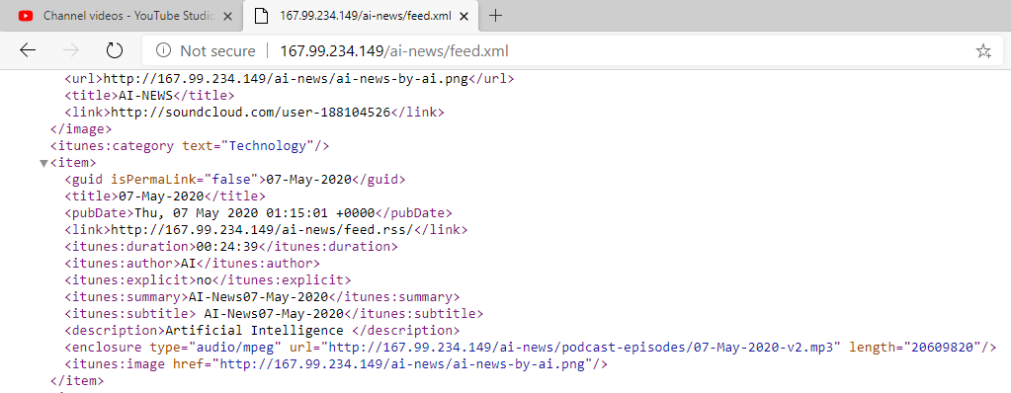
.XML files updated
http://167.99.234.149/ai-news/feed.xml

Slide 13
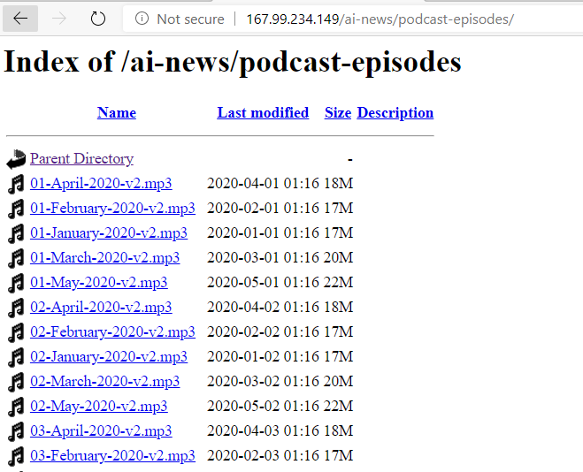
Output files generated in the server
http://167.99.234.149/ai-news/podcast-episodes/

Slide 14
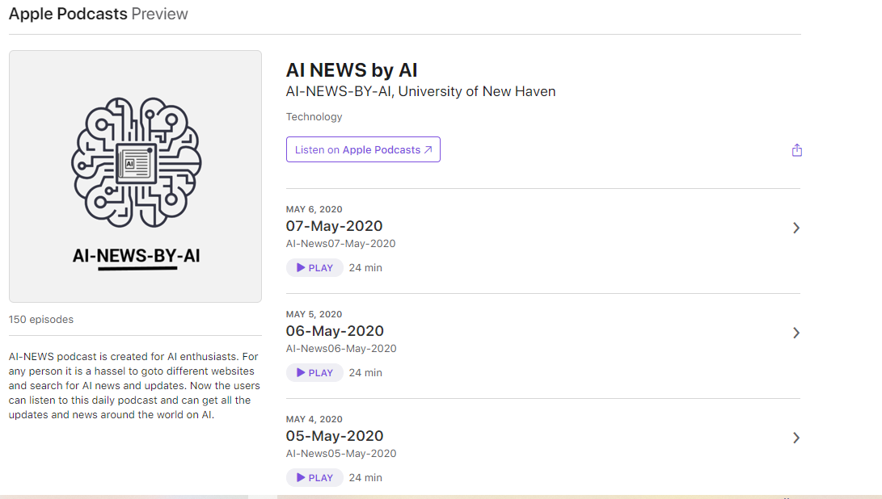
iTunes Podcast channel
https://podcasts.apple.com/us/podcast/ai-news-daily/id1491115711

Slide 15
Thank you!

